Slide 1
Response surface methodology
STAT 4442 Spring 2021
Ethan Engel

Slide 2


OUtcome Variable: Global Hunger IndeX- continuous (GHI_SCORE)
This data comes from https://dataverse.harvard.edu/
GHI has four components:
Portion of population that is undernourished
Portion of child population that is experiencing "wasting" – underweight for the height
Portion of child population that is experiencing "stunting" - low height for the age
Child mortality rate

Slide 3
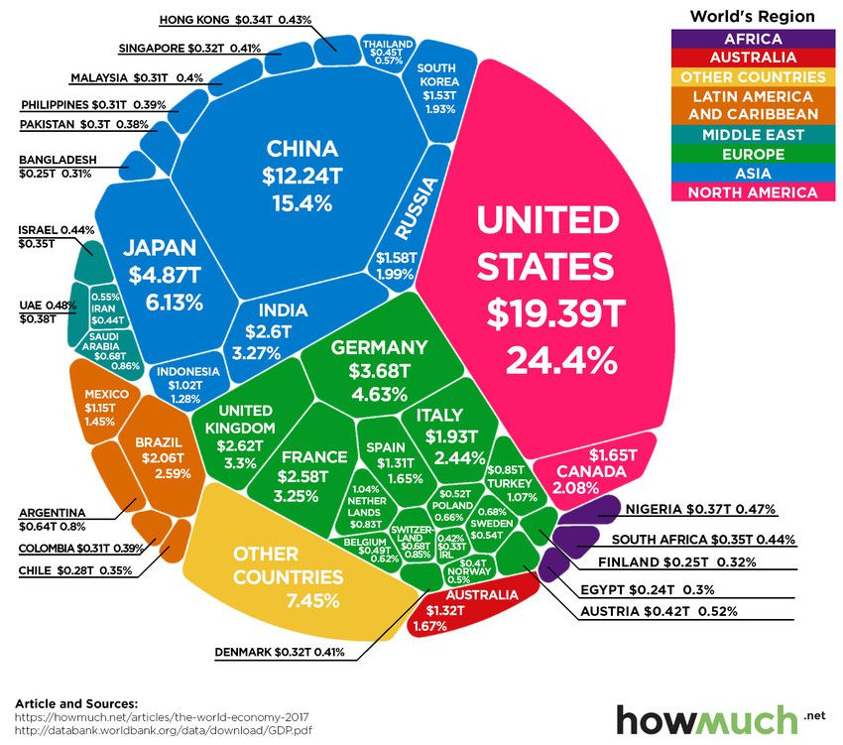
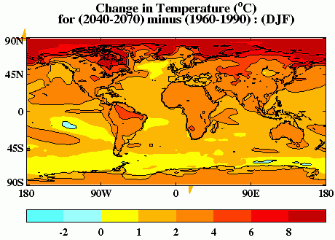

Predictor Variables(All continuous)
Fragile State Index
(FSI_score)
GDP per Capita
(GDP_capita)
Temperature Change
(curr_temp_change)
From: https://fragilestatesindex.org/global-data/
An FSI score for a nation is a measure of its degree of conflict, corruption and ongoing human rights violations.
From:
http://data.un.org/Data.aspx?q=GdP&d=SNAAMA&f=grID%3A101%3BcurrID%3AUSD%3BpcFlag%3A1
From: http://www.fao.org/faostat/en/#data/ET
This is the most current average temperature data compared to baseline climatology years of 1950-1980.

Slide 4
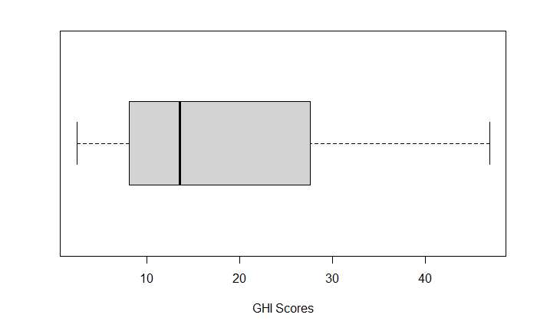
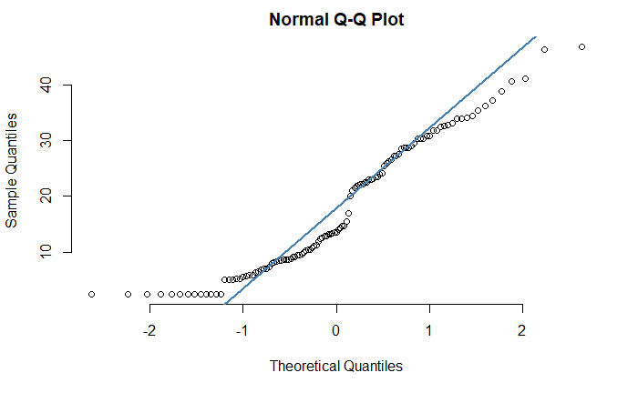
EXPLoratory Analysis of Outcome variable
Although there are no outliers, the 117 GHI scores are skewed right.
The GHI scores are showing evidence of non-normality. Luckily, response surface regression is more robust to violations of normality than Multiple Linear Regression.

Slide 5
Can an Informative model to predict optimal conditions for Famine be developed from this data?
Can a model developed from RSM, in this instance, be more informative than a model developed from MLR alone?

Slide 6
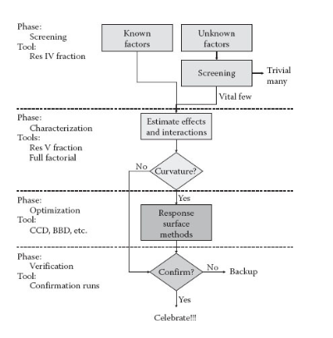
Response Surface Methodology (Regression)
1) Fits data to a series of polynomial models. Perhaps the curvature of quadratic terms results in a better fit.
2) Beyond second order in the progression immediately increases risk of overfitting.*
3) Goal is often optimization; Gradient & steepest ascent are used.
4) Like with MLR, factor variables can be used as predictors.
5) Model comparison methods are employed.

Slide 7
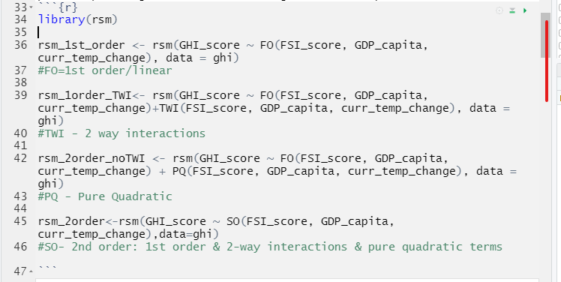
Rsm library and function call
Primary arguments:
1) FO – First Order
2) TWI – Two-way interactions
3) PQ – Pure Quadratic
4) SO – Second Order; equivalent to FO + TWI + PQ
(No 3rd order)

Slide 8
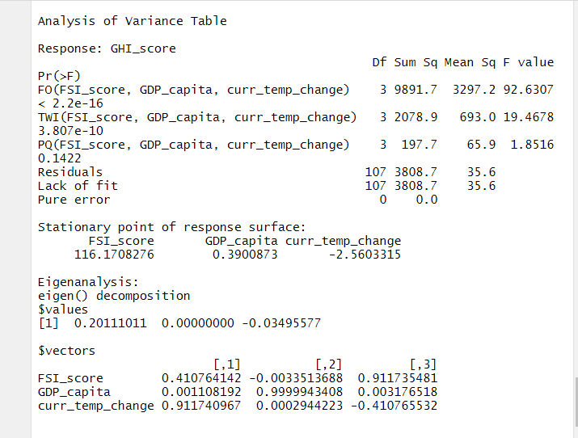
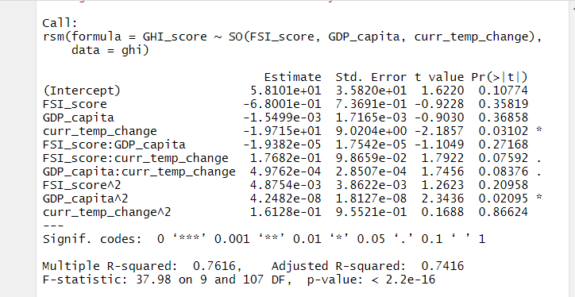
RSM Model Summary
Old news:
Extended Summary metrics:

Slide 9
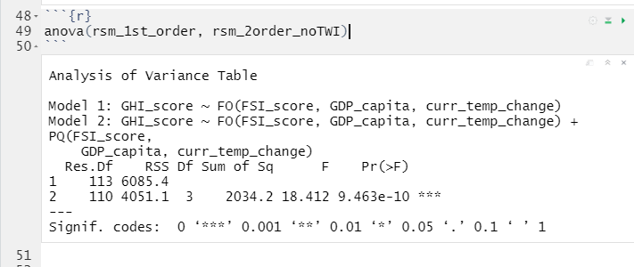
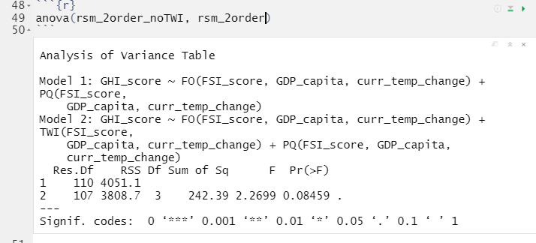
Model Comparisons Informative? FIT?
1st Order vs.
1st Order + Quadratic Terms
1st Order + Quadratic Terms vs.
Full 2nd Order Model
Adding the quadratic terms significantly improved the model.
AIC dropped from 804 to 763.
Adding the two-way interaction terms did not significantly improve the model.
AIC did not significantly drop.

Slide 10
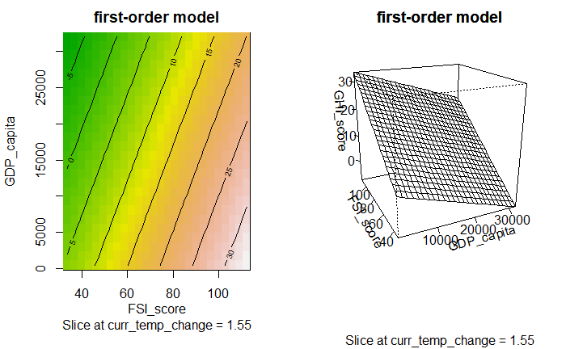
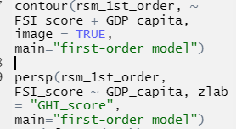

Graphing Response Surfaces – contour & Perspective Plots

Slide 11
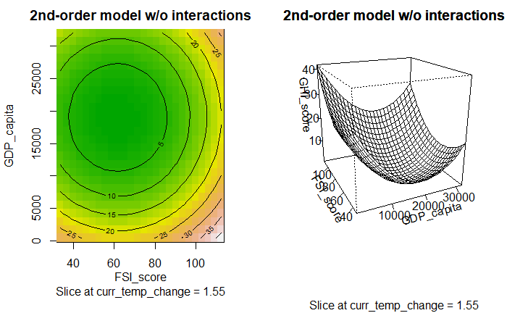
Response surface – Second Order Model

